Slide 1

OLA CASE STUDY
Harsh Wardhan Singh

Slide 2
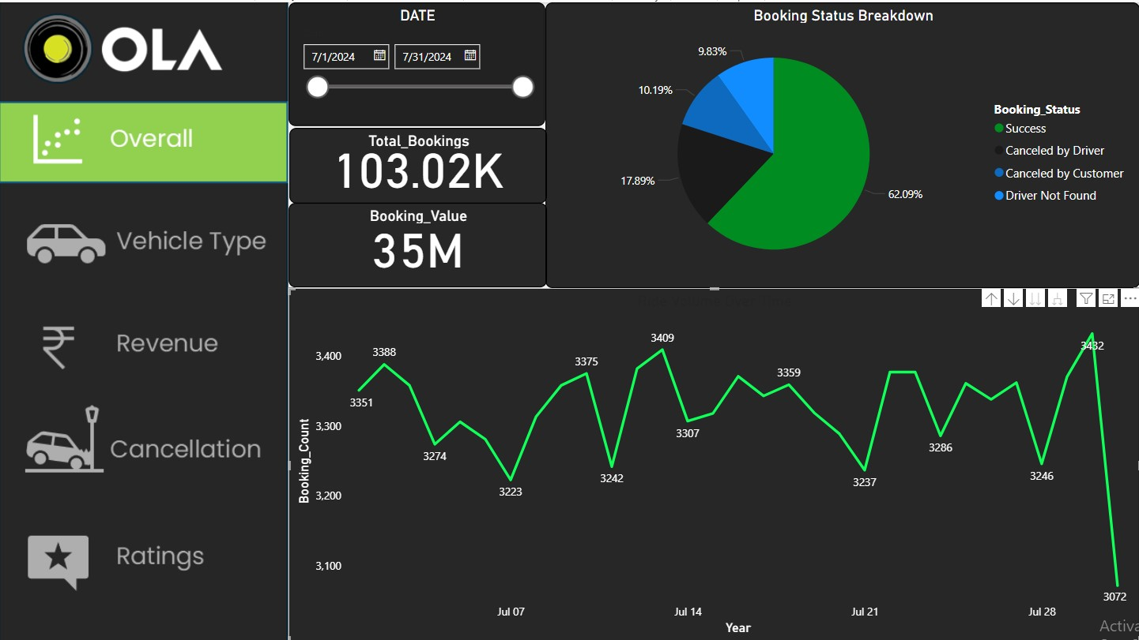
1.Ride Volume Over Time: A time-series chart showing the number of rides per day/week. 2. Booking Status Breakdown: A pie or doughnut chart displaying the proportion of different booking statuses (success, cancelled by the customer, cancelled by the driver, etc.).

Slide 3
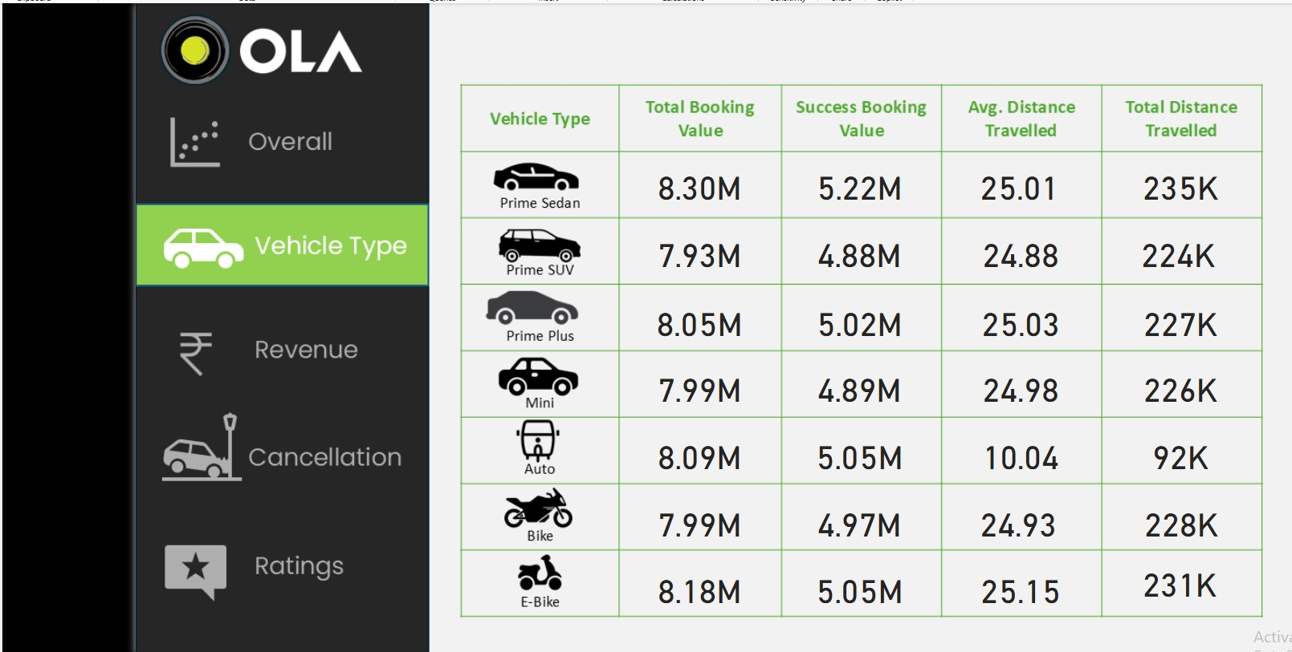
Top 5 Vehicle Types by Ride Distance: A chart ranking vehicle types based on the total distance covered.

Slide 4
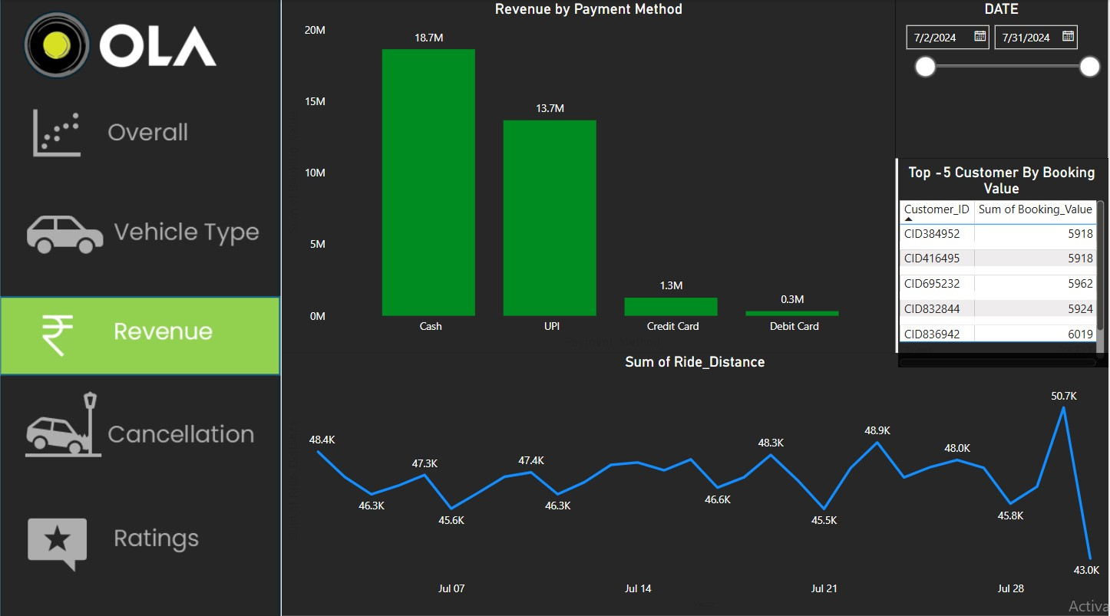
1. Revenue by Payment Method: A stacked bar chart displaying total revenue based on payment methods (Cash, UPI, Credit Card, etc.). 2. Top 5 Customers by Total Booking Value: A leaderboard visual listing customers who have spent the most on bookings. 3. Ride Distance Distribution Per Day: A histogram or scatter plot showing the distribution of ride distances for different Dates.

Slide 5
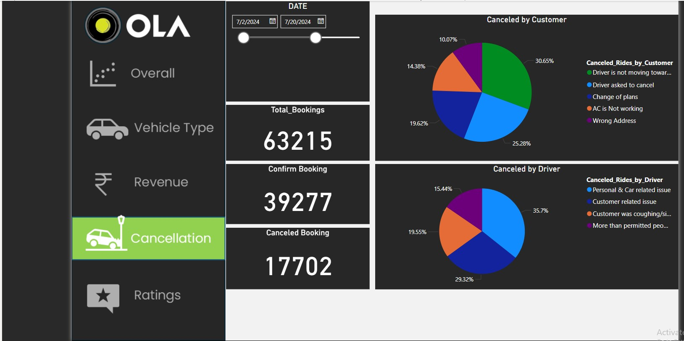
Cancellation - Cancelled Rides Reasons (Customer) & cancelled Rides Reasons(Drivers).

Slide 6
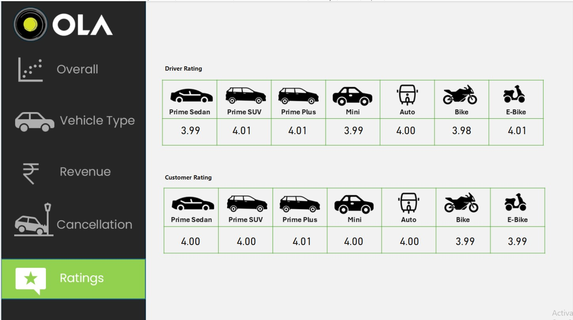
Ratings - Driver Ratings & Customer Ratings

Slide 7
Thank you!

